Slide 1

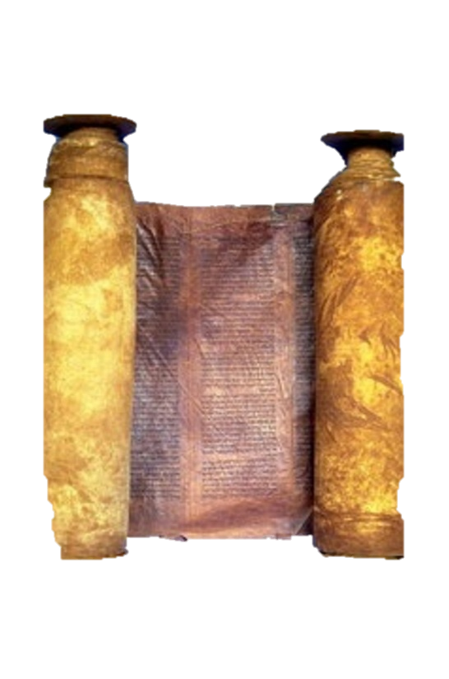




A free CD of this message will be available immediately following the service
1 Kings
9.1-11.13
A podcast will also be available later this week at calvaryokc.com

Slide 2



Which is exalted ~ NASB (better), will become a heap of ruins
1 kings 9.1-11.13

Slide 3
1 kings 9.1-11.13

Slide 4
2 Chron. 7.14 ~ and My people who are called by My name humble themselves and pray and seek My face and turn from their wicked ways, then I will hear from heaven, will forgive their sin and will heal their land.
1 kings 9.1-11.13

Slide 5
1 Cor. 10.12 ~ Therefore let him who thinks he stands take heed lest he fall,
1 kings 9.1-11.13

Slide 6
1 kings 9.1-11.13

Slide 7
Cabul ~ worthless
1 kings 9.1-11.13

Slide 8
1 kings 9.1-11.13

Slide 9
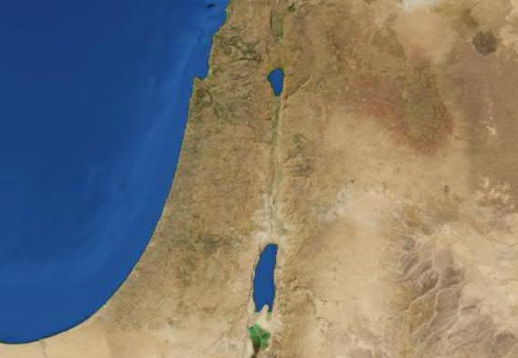
Hazor
Megiddo
Jerusalem
Gezer
1 kings 9.1-11.13

Slide 10
1 kings 9.1-11.13

Slide 11
Deut. 16.16 ~ Three times a year all your males shall appear before the Lord your God in the place which He chooses: at the Feast of Unleavened Bread, at the Feast of Weeks, and at the Feast of Tabernacles; and they shall not appear before the Lord empty-handed.
1 kings 9.1-11.13

Slide 12
1 kings 9.1-11.13

Slide 13
Hard questions ~– normally translated riddle
Same as Judges 14.12
1 kings 9.1-11.13

Slide 14
1 kings 9.1-11.13

Slide 15
Spirit ~ ruach - spirit, wind, breath
1 kings 9.1-11.13

Slide 16
1 kings 9.1-11.13

Slide 17
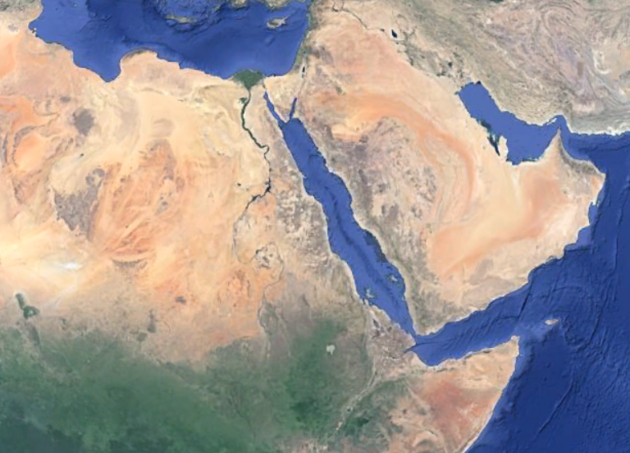
Sheba?
Sheba?
1 kings 9.1-11.13

Slide 18
1 kings 9.1-11.13

Slide 19
Shields ~ KJV, targets
1 kings 9.1-11.13

Slide 20
1 kings 9.1-11.13

Slide 21
Monkeys ~ KJV, NASB, peacocks; NIV, baboons
1 kings 9.1-11.13

Slide 22
1 kings 9.1-11.13

Slide 23
Foreign women ~ KJV, strange
1 kings 9.1-11.13

Slide 24
1 kings 9.1-11.13

Slide 25
Ps. 86:11 ~ Teach me Your way, O Lord;
I will walk in Your truth;
Unite my heart to fear Your name.
1 kings 9.1-11.13

Slide 26
1 kings 9.1-11.13

Slide 27
Kidron Valley
Tyropoeon Valley
Temple
Mount of Olives
Hinnom Valley
Palace
City of David
1 kings 9.1-11.13

Slide 28
1 kings 9.1-11.13

Slide 29
Deut. 17:14-20 ~ ¹⁴ When you come to the land which the Lord your God is giving you, and possess it and dwell in it, and say, "I will set a king over me like all the nations that are around me," ¹⁵ you shall surely set a king over you whom the Lord your God chooses; one from among your brethren you
1 kings 9.1-11.13

Slide 30
shall set as king over you; you may not set a foreigner over you, who is not your brother. ¹⁶ But he shall not multiply horses for himself, nor cause the people to return to Egypt to multiply horses, for the Lord has said to you, "You shall not return that way again." ¹⁷ Neither shall he multiply wives for
1 kings 9.1-11.13

Slide 31
himself, lest his heart turn away; nor shall he greatly multiply silver and gold for himself.
¹⁸ Also it shall be, when he sits on the throne of his kingdom, that he shall write for himself a copy of this law in a book, from the one before the priests, the Levites. ¹⁹ And it shall be with him, and he
1 kings 9.1-11.13

Slide 32
shall read it all the days of his life, that he may learn to fear the Lord his God and be careful to observe all the words of this law and these statutes, ²⁰ that his heart may not be lifted above his brethren, that he may not turn aside from the commandment to the right hand or to the left, and that he may prolong
1 kings 9.1-11.13

Slide 33
his days in his kingdom, he and his children in the midst of Israel.
1 kings 9.1-11.13

Slide 34
1 kings 9.1-11.13

